Slide 2
Editors
Sarah E. Braddock Clarke is Senior Lecturer and researcher,
Falmouth University, UK and co-author of Digital Visions for Fashion + Textiles (2012), Techno Textiles 2 (2005), SportsTech (2002),
and Techno Textiles (1998).
Ryoko Yamanaka Kondo is Emeritus Professor,
Tohoku University of Art and Design, Yamagata, Japan and researcher at the Institute for European, Medieval and Renaissance Studies,
Waseda University, Tokyo, Japan.

Slide 3
Bloomsbury Publishing – Bloomsbury Visual Arts
With over 200 colour illustrations, Byzantine Silk on the Silk Roads examines in detail the eclectic iconography of the Byzantine period and its impact on design and creativity today. Through an examination of the extraordinary variety of designs in these captivating silks, an international team of experts reveals that Byzantine culture was ever-moving and open to diverse influences across the length of the Silk Road.

Slide 4
The Silk Roads

Slide 5
Dolce & Gabbana ‘Tailored Mosaic’, Autumn/Winter 2013/2014, womenswear, prêt-à-porter Inspired by the Santa Maria Nuova Cathedral (Monreale Cathedral), Palermo, Sicily

Slide 6
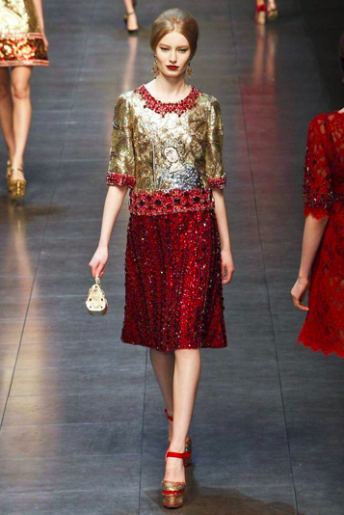

Slide 7
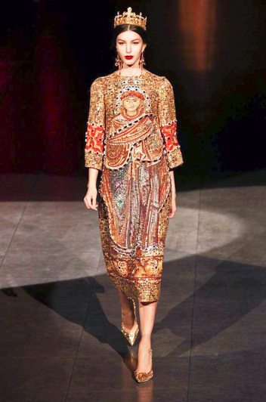

Slide 9
Victoria & Albert Museum, London Textile fragment, woven silk (compound twill), head of a griffin above part of an elephant’s trunk within a roundel, Istanbul, around 10th to 11th century

Slide 10
Monreale Cathedral – Santa Maria Nuova, Palermo, Sicily A view towards the altar, 12th to 13th century

Slide 11
Mosaic depicting King William II of Sicily presenting a model of Monreale Cathedral to the Virgin Mary

Slide 12
Wall painting Afrāsiāb The kingdom of Sogdian, Samarkand (Central Asia), 7th century

Slide 13
British Museum, London Silk textile panel intended as a sleeve ornament on a tunic, Egypt, 8th century

Slide 14
Victoria & Albert Museum, London Woven silk (lampas) – exotic birds and vine leaves, probably Iran, 14th century

Slide 15
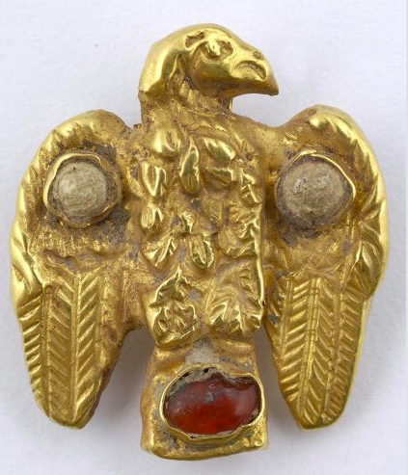
Benaki Museum, Athens Gold heraldic eagle decorated with a garnet and glass paste, 6th to 7th century Gold earrings with glass paste, emeralds, and cornelians, 4th century

Slide 16
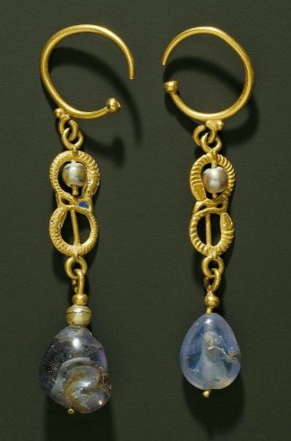
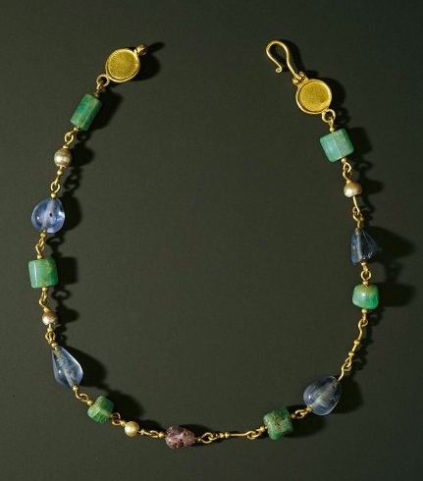
Gold earrings with sapphires and pearls, Antinoë, Egypt, 5th century Gold necklace - sapphires, amethysts, emeralds, pearls, Antinoë, Egypt, 5th century

Slide 17
Basilica of San Vitale, Ravenna Mosaic depicting Empress Theodora and her courtiers, 6th century - around 547

Slide 18
Mosaic depicting Emperor Justinian and his courtiers

Slide 19
Empress Theodora

Slide 20
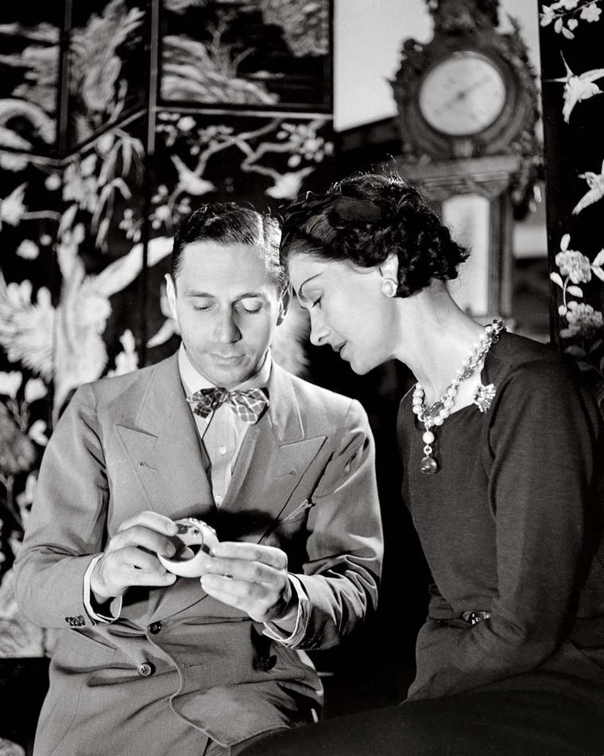
Gabrielle ‘Coco’ Chanel and Fulco di Verdura Byzantine-inspired jewellery – ‘Maltese Cross’ cuff, 1937

Slide 21
Verdura ‘Maltese Cross’ cuffs – enamel with cabochon stones

Slide 22
Karl Lagerfeld for the House of Chanel ‘Paris-Byzance’, Métiers d’Art, Pre-fall 2011, womenswear - embellishment by Lesage

Slide 24
‘Tejido de las Estrellas’ (Woven Textile with Stars), fragment from the vestments of St. Valerius, 13th century

Slide 25
Cape of St. Valero, Spain 13th century

Slide 26
Gianni Versace Autumn/Winter 1997/1998, womenswear, haute couture

Slide 27
Victoria & Albert Museum, London Gianni Versace - Oroton (mesh-like metallic fabric) dress with applied beadwork

Slide 28
The Metropolitan Museum of Art, New York Gianni Versace, ‘Heavenly Bodies: Fashion and the Catholic Imagination’ exhibition, 2018

Slide 29
Alexander McQueen Autumn/Winter 2010/2011, womenswear, prêt-à-porter

Slide 30
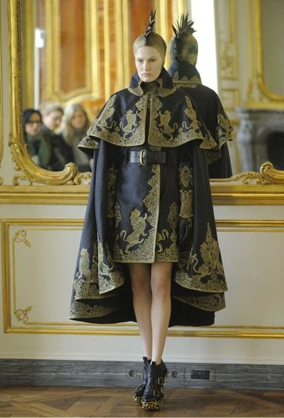

Slide 31
Treasure House of St. Heribert, Cologne Silk samite depicting lions, 10th to 11th century Inscription: Emperor Basil II and his brother Constantine II

Slide 32
Valentino - Maria Grazia Chiuri and Pierpaolo Piccioli Spring 2016, womenswear, haute couture

Slide 34
Ceiling mosaic, Mausoleums of Santa Costanza, Rome A peacock and a bird amongst foliage, flowers, and fruit trees, 4th century

Slide 35
Victoria & Albert Museum, London Silk samite of peacocks followed by unicorns, Spain (probably Almeria), 1100-1150

Slide 36
Thierry Mugler ‘La Chimère’, Autumn/Winter 1997/1998, womenswear, haute couture

Slide 37
‘Thierry Mugler: Couturissime’ Exhibition – Brooklyn Museum, New York, 18 November 2022 to 07 May 2023 Yasmin Le Bon, Palladium, London, 1997

Slide 38
Chinese jin Woven Textile excavated at Niya Minfeng, Xinjiang Institute of Culture and Archaeology

Slide 39
Lindau Gospels Inside back cover – samite woven in Syria depicting griffins and birds (most likely peacocks) surrounded by flowers in a lozenge composition, 8th to 9th century

Slide 40
Striped silk - lampas weave, Iran or Iraq Silk, Seljuq period, 12th century

Slide 41
Valentino - Maria Grazia Chiuri and Pierpaolo Piccioli Spring 2014, womenswear, prêt-à-porter

Slide 42
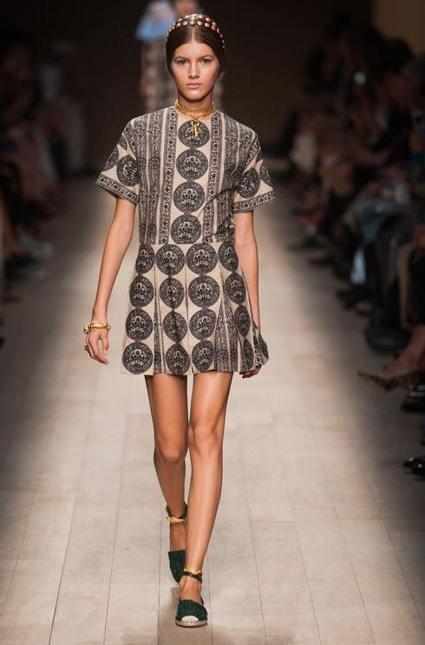

Slide 43
Decoration - two birds within a roundel Manastir (now Bitola), North Macedonia, 13th century

Slide 44
Cloth of gold – lampas weave, Central Asia Silk and gold thread, Ilkhanid period, mid-13th century

Slide 45
Aachen Cathedral, ‘Elephant Silk’ Silk samite, made in Constantinople, 10th to 11th century

Slide 46
Textiles, confronting horses/birds in beaded medallions Turfan, Uygur Autonomous Region Museum, Urumqi, Xinjiang Left to right – 653; 558-576; 541-596

Slide 47
‘Samite with Design of Rhinoceros in Beaded Medallion’ Reproduction by Tatsumura Textile Co. Ltd., Kyoto

Slide 48
'Samite with Design of Rhinoceros in Beaded Medallion’ Fragments, Shōsō-in Treasure House, Tōdai-ji Temple, Nara, 8th century

Slide 49
‘Samite with Design of Rhinoceros in Beaded Medallion’ Design sketch of the reproduction – illustration by Kiyoshi Tatsumura

Slide 50
Etro Designed by Veronica Etro, Autumn/Winter 2009/2010, womenswear, prêt-à-porter

Slide 51
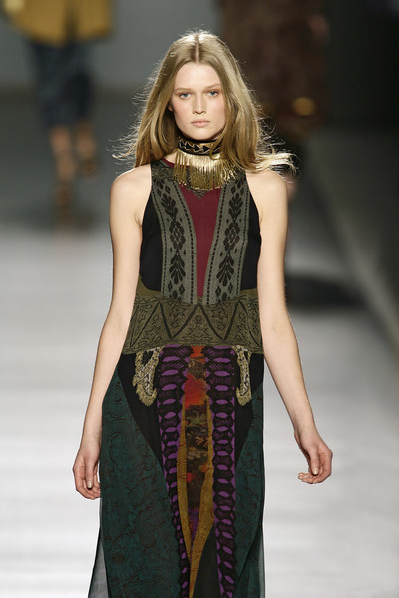

Slide 52
Warp-faced silk Depicting trees, confronted goats, and confronted birds pattern Excavated from Astana, Turpan, Xinjiang Uyghur Autonomous Region in 1972

Slide 53
Lampas woven silk textile Crowned lions and inverted escutcheons, 15th century

Slide 54
Embroidered textile Riding on cloud imagery Excavated from Tomb no. 1 at Mawangdui in Changsha, Hunan Province in 1972

Slide 55
Victoria & Albert Museum, London ‘Byzantin’ fashion design by Madeleine Wallis for Paquin Ltd., Paris, 1923

Slide 56
Virginie Viard for the House of Chanel ‘Maltese Cross’ sweater, Autumn/Winter 2020/2021, womenswear, prêt-à-porter

Slide 57
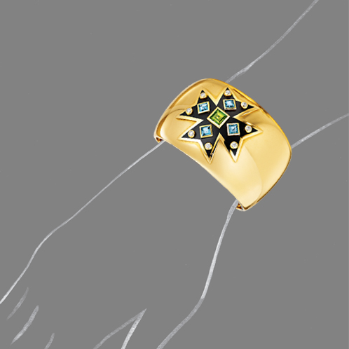
Verdura Byzantine-inspired contemporary jewellery

Slide 58
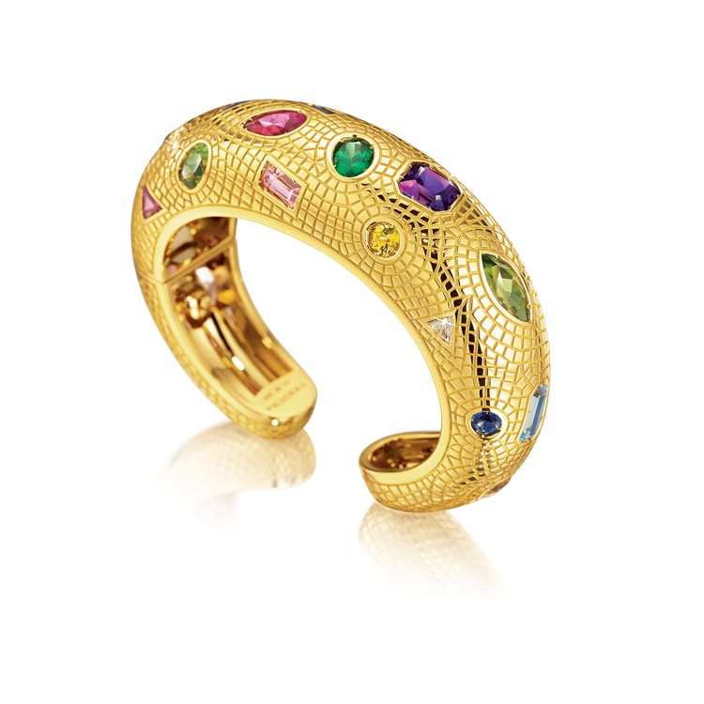

Slide 59
Byzantine Silk on the Silk Roads: Journeys between East and West, Past and Future
Reviews:
"A wide-ranging exploration of the borderless terrains traversed by the alluring patterns and complex looms that created the most treasured cloths in the Medieval period and continue to inspire today." --Mary Schoeser, V&A, The Textile Society and the School of Textiles, UK
"A must-read for scholars and students of textile design ... Thoroughly researched and beautifully illustrated." --Steeve Buckridge, Grand Valley State University, USA
"A detailed, comprehensive and lavishly illustrated study of Byzantine Silk, offering a genuinely transcultural perspective on the manufacture and dissemination of these key textiles." --Craig Benjamin, Grand Valley State University, USA

Slide 61
Image Credits
1. Bloomsbury Publishing Plc. - Bloomsbury Visual Arts - photograph by Giuseppe Cacace/AFP/Getty Images
2. Bloomsbury Publishing Plc. - Bloomsbury Visual Arts
3. Bloomsbury Publishing Plc. - Bloomsbury Visual Arts
4. Getty Images/Iukbar
5. Photograph by Giuseppe Cacace/AFP/Getty Images
6. SHOWstudio
7. SHOWstudio
8. Photograph by Victor Virgile/Gamma-Rapho/Getty Images
9. Victoria & Albert Museum
10. Christie’s - photograph by Antonino Bartuccio/4Corners
11. Christie’s - photograph by DeAgostini Picture Library/Scala, Florence
12.. L. I. Aribaum, Mural of Ancient Samarkand, trans. Kyusaku Katou. Tokyo: Bunka Shuppan Kyoku, 1980
13. British Museum
14. Victoria & Albert Museum
15. Benaki Museum
16. Benaki Museum
17. The Metropolitan Museum of Art
18. The Metropolitan Museum of Art
19. Verdura
20. Photographs by Lipnitzki/Getty Images - Town and Country Mag and The Jewellery Editor
21. The Jewellery Editor
22. Photograph by François Guillot/AFP/Getty Images
23. Chanel
24. Centre de Documentació i Museu Tèxtil / Photograph by Quico Ortega
25. Photograph by Ryoko Yamanaka Kondo
26. Photograph by Niall McInerney – Bloomsbury Publishing Plc.
27. Victoria & Albert Museum
28. The Metropolitan Museum of Art
29. Photograph by Andrew H. Walker/Getty Images
30. Photographs by Giovanni Giannoni – Women’s Wear Daily

Slide 62
Image Credits
31. Photographs by Ryoko Yamanaka Kondo
32. Photograph by Stephane Cardinale/Corbis via Getty Images
33. The Glass Magazine
34. Photograph by Ryoko Yamanaka Kondo
35. Victoria & Albert Museum
36. Photograph by Niall McInerney – Bloomsbury Publishing Plc.
37. Photograph by Alan Strutt, Evening Standard, October 1997 - Brooklyn Museum
38. Dieter Kuhn, ed., Chinese Silks. New Haven, CT and London: Yale University Press, 2012, Plate 3.34a
39. The Morgan Library & Museum, New York City, NY
40. The Cleveland Museum of Art, Dudley P. Allen Fund
41. Photograph by Victor Virgile/Gamma-Rapho via Getty Images
42. Harper’s Bazaar
43. Dr Tomoyuki Masuda
44. The Cleveland Museum of Art, Purchase from the J. H. Wade Fund
45. Alamy
46. Photograph by Dr Kazuko Yokohari
47. Photograph by Tatsumura Textile Co. Ltd.
48. Shōsō-in Treasure House
49. Illustration by Kiyoshi Tatsumura
50. Photograph by Damien Meyer/AFP/Getty Images
51. Livingly
52. Xinjiang Uyghur Autonomous Region Museum
53. Centre de Documentació i Museu Tèxtil / Photograph by Quico Ortega
54. Hunan Museum, Hunan Province, China
55. Victoria & Albert Museum
56. Photograph by Victor Virgile/Getty Images - Town and Country Mag
57. Verdura
58. Verdura
59. Bloomsbury Publishing - Bloomsbury Visual Arts
60. Bloomsbury Publishing Plc. - Bloomsbury Visual Arts - photograph by Giuseppe Cacace/AFP/Getty Images

